Slide 1

piezoelectricity
Are piezoelectric materials worth the investment to decelerate climate change?

Slide 2

So, what are piezoelectric materials?
Piezoelectric materials are certain solids, such as crystals or ceramics that can accumulate an electric charge.
These materials are placed under mechanical stress or vibrations, which result in a deformation.
Piezoelectric crystals have a diameter around 10-16mm, implying they take up very little amounts of room.
It is said that with an even distribution of these renewable energy devices, over a one-kilometre stretch of road, 400kW can be generated
This is enough to charge over 162 homes

Slide 3
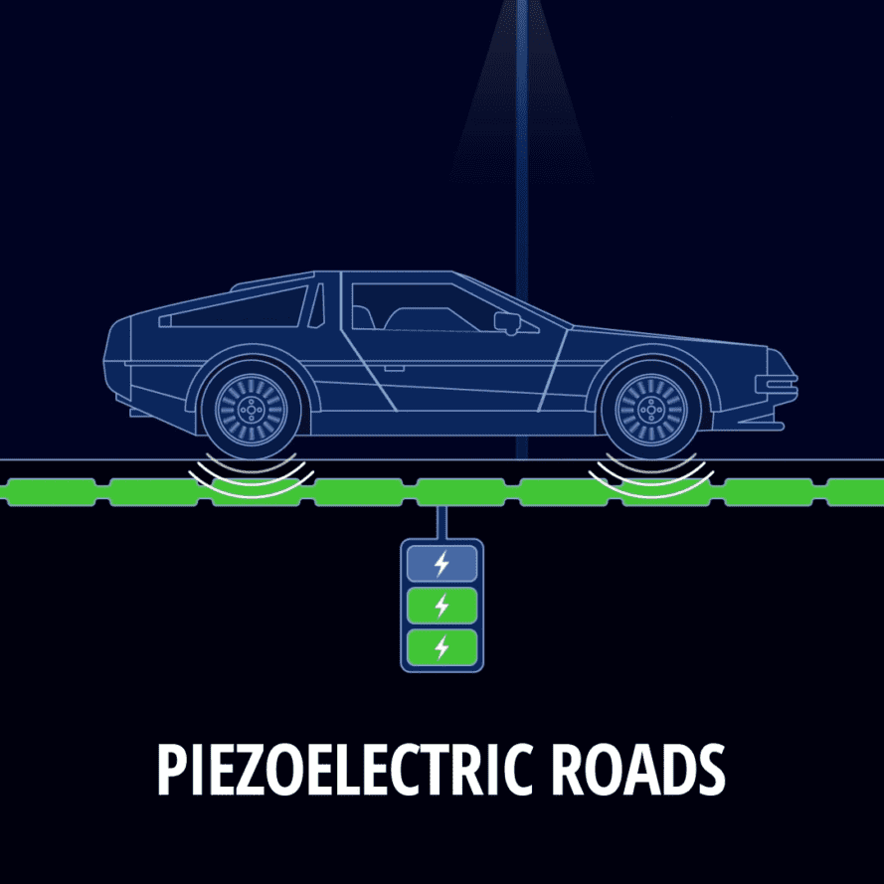
How useful can we make it right now?
As the UK is a small country compared to the likes of America, taking built up American cities makes more sense.
Let's take 4 major American cities. New York, Los Angeles, Chicago and Houston.
As a collective, these 4 cities have over 53,000 kilometres of public road. Using the statistics from earlier, that means over 42.1 million watts of power can be generated annually. Just through using these small crystals.
But what makes these materials better than currently used materials like fossil fuels?
Not only are they renewable, but piezoelectricity have an efficiency of up to 95%
Fossil fuels – 35%
Solar Panels- 20%
These crystals are placed around 5cm below the asphalt in the road, allowing it to take in a near maxima of pressure without getting crushed and ruined.
Although these crystals are long lasting, they have their disadvantages:
Require high maintenance- a long job requiring lots of workers
May take a while to insert in roads, and therefore leading to high amounts of temporary traffic in different areas, especially in the example
Overall, can be very expensive.

Slide 4

Overall is it worth it and what next?
Overall, piezoelectricity does not directly lower climate change, however, it contributes to the increase of sustainable energy and therefore helps in the deduction of carbon-emitting resources, making it worth the investment.
Research shows that structural elements within the body can conduct an electric current through bones, DNA and proteins. With the development of nanotechnology, in the far future, me have high potential to generate electrical energy through human motion.
As of today, the population stands at a staggering 8.1 billion, meaning with this future development, enough energy will be gathered to charge extremely high amounts of land across the world, if not the whole globe.
80% of all energy production comes from carbon emissions, dropping this as much as possible makes it worth the investment.
However, this is a long process meaning right now it isn’t being utilized to the potential it has.
Research reckon the development could be active from 2030 onwards.
Meaning this is a subject for future investment as it has unlimited amounts of potential with high demand.
This be high demand as research reckons fossil fuels will run out by the year 2060, if rates stay the same.

Slide 5

Thank You for listening

